Slide 1

DJANGO WEB FRAMEWORK
SOFTWARE METRICS MEASUREMENT USING RADON AND PYLINT
by
BOREDA ANAND (16L01A0507)
A.ANIL KUMAR (16L01A0501)
SYED MOIZUDDIN (16L01A0546)
M.YASHWANTH (16L01A0525)
Under the guidance of
R. Vinod Kumar
Assistant Professor

Slide 2
LIST OF CONTENTS
Introduction
Feasibility
Analysis
Design
Implementation
Testing
Output screens
Conclusion
Future enhancement
References

Slide 3


INTRODUCTION
Django framework is a compact Python framework intended for quick development
we will find out software metrics for Django using Radon that provides cyclomatic complexity raw metrics that consists SLOC, comment lines, number blank lines, Maintainability Index and Halstead metrics, also use Pylint
Pylint is a source code analyzer that finds for errors in programming, assists to use a coding standard strictly.

Slide 4
FEASIBILITY

Slide 5

FEASIBILITY
Business proposal is put forth with a very general plan for the project and some cost estimates
Requirements :
Economical feasibility
Technical feasibility
Social feasibility

Slide 6
FEASIBILITY
Economic study : carried out to check the economic impact that the system will have on the organization
Technical study : carried out to check the technical feasibility, that is, the technical requirements of the system
Social Feasibility: study is to check the level of acceptance of the system by the user

Slide 7
ANALYSIS

Slide 8
EXISTING SYSTEM
Flask framework is a Python micro-framework with a moderate approach and powerful by itself. Flask perfect for stand-alone applications and rapid prototyping.
Pyramid known as Pylons is a framework that gives reproducibility with NoSQL integration. Pyramid best for APIs, prototyping, and extensive web apps, like content management systems development.
Tornado is an event-based, non-blocking Python web server and web application framework serve high-traffic volume. The Bottle is a light and simple microframework.

Slide 9
DISADVANTAGES
There will be times as a software developer when a programmer works on projects that do not have unit tests, a daily build, a mess of legacy spaghetti code
Lines of code (LOC) are the most simple indicators and warnings. A massive, complicated project will have hundreds of thousands of LOC and that normal if the project is well-managed.

Slide 10
PROPOSED SYSTEM
Django is a framework for web development using python and created for the quick development of database driven sites
It focuses inefficiency, giving developer to do almost all tasks with as little coding effort as possible.

Slide 11
ADVANTAGES
LLOC: The variety of logical strains of code. Each logical line of code contains precisely one statement.
SLOC: The quantity of source lines of code. It does not relate to the LLOC.
LOC: The aggregate number of lines of code. It doesn't relate to the number of lines in the file.
Multi: The number of lines that represent multiline strings.
Comments: The number of comment lines. Multiline strings are not considered comment, to the Python, they are just strings.

Slide 12

HARDWARE REQUIREMENTS
System : Pentium IV 2.4 GHz.
Hard Disk : 40 GB.
Floppy Drive : 1.44 Mb.
Monitor : 14’ Colour Monitor.
Mouse : Optical Mouse.
Ram : 512 Mb.

Slide 13
SOFTWARE REQUIREMENTS
Operating system : Windows 7 Ultimate.
Coding Language : Python.
Front-End : Python.
Designing : Html, CSS, JavaScript.
Data Base : MySQL.

Slide 14
DESIGN

Slide 15
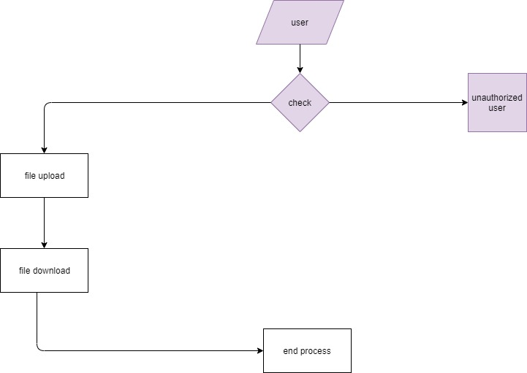

DATA FLOW DIAGRAMS
User
Admin

Slide 16
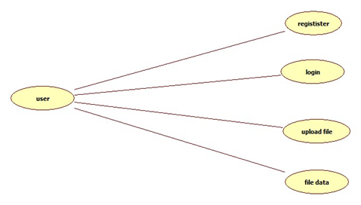
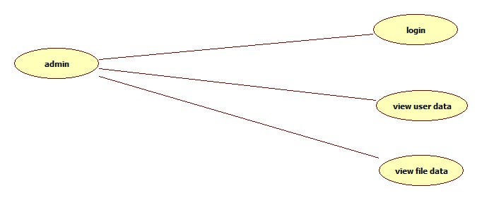
USE CASE DIAGRAMS
User
Admin

Slide 17
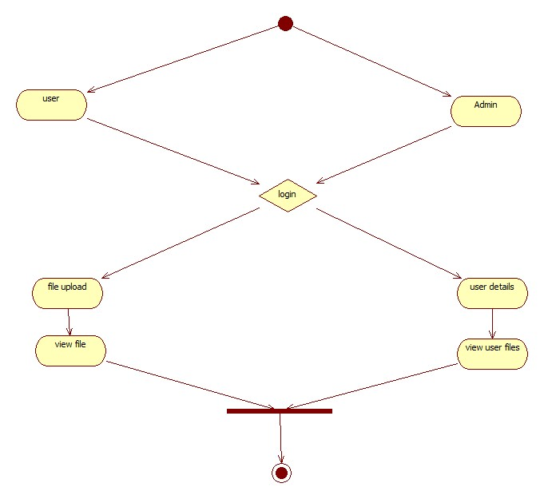
ACTIVITY DIAGRAM

Slide 18
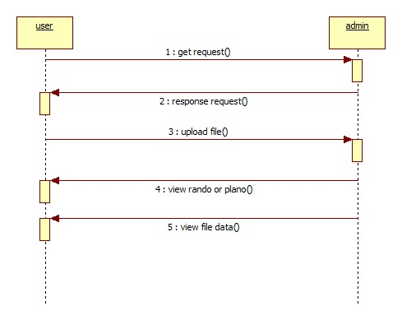
SEQUENCE DIAGRAM

Slide 19
IMPLEMENTATION

Slide 20
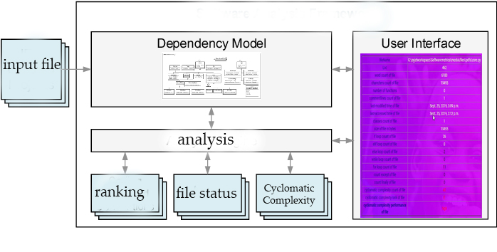
SYSTEM ARCHITECTURE

Slide 21
TESTING

Slide 22

UNIT TESTING
Involves the design of test cases that validate that the internal program logic is functioning properly
It is the testing of individual software units of the application
INTEGRATION TESTING
Designed to test integrated software components to determine if they actually run as one program
Integration testing is specifically aimed at exposing the problems that arise from the combination of components

Slide 23
SYSTEM TESTING
Ensures that the entire integrated software system meets requirements
Configuration-oriented system integration test
WHITE BOX TESTING
Software tester has knowledge of the inner workings, structure and language of the software, or at least its purpose
It is used to test areas that cannot be reached from a black box level.

Slide 24

BLACK BOX TESTING
Black Box Testing is testing the software without any knowledge of the inner workings, structure or language of the module being tested
It also ensures that the system meets the functional requirements.
ACCEPTANCE TESTING
User Acceptance Testing is a critical phase of any project and requires significant participation by the end user.
It also ensures that the system meets the functional requirements.

Slide 25
TEST CASES
S.no | Test Case | Excepted Result | Result | Remarks (IF Fails)
1 | user registration | If user filled all form fields should be registered successfully. | Pass | If user is filled the form fields.
2 | ADMIN | user rights will be approved here. | Pass | If user is not registered.
3 | user LOGIN | If user name and password is correct then it will be getting valid page. | Pass | If user name or password is not correct.
4 | user upload code file | If user is correct then it will be getting valid page. | Pass | If user is not correct.
5 | Admin view | Admin can view user data. if admin id and password is correct.it will show valid page. | Pass | If admin is not correct.
6 | User view | If user is logged in then show analysis | Pass | If user is not logged in.

Slide 26
OUTPUT SCREENS

Slide 27
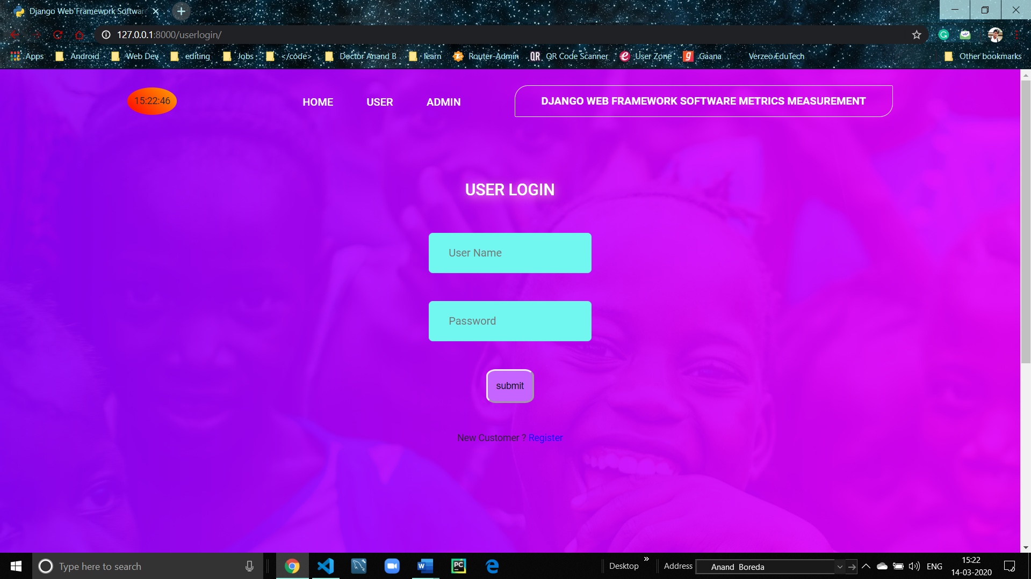

Slide 28
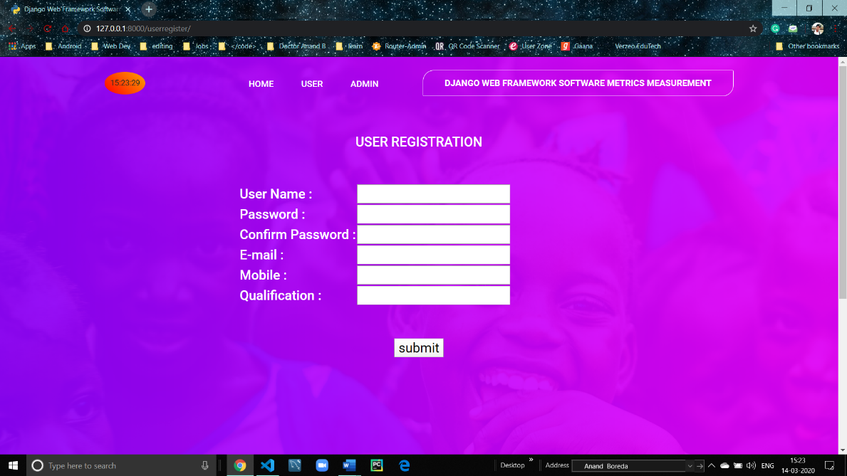

Slide 29
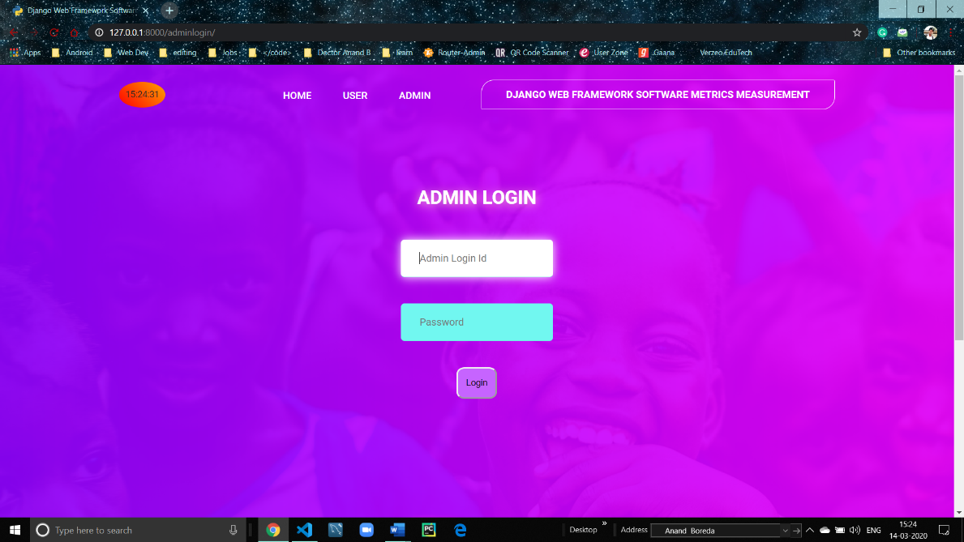

Slide 30
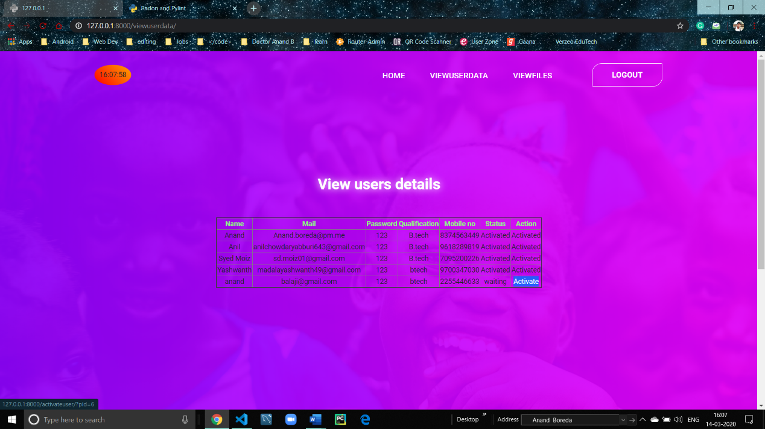

Slide 31
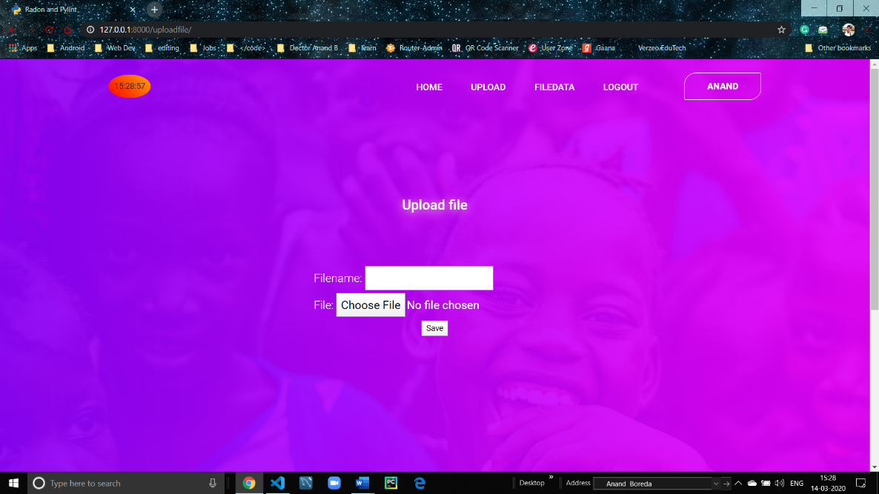

Slide 32
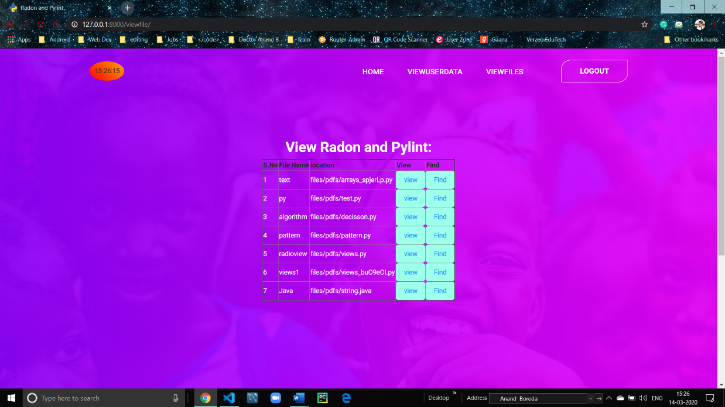

Slide 33
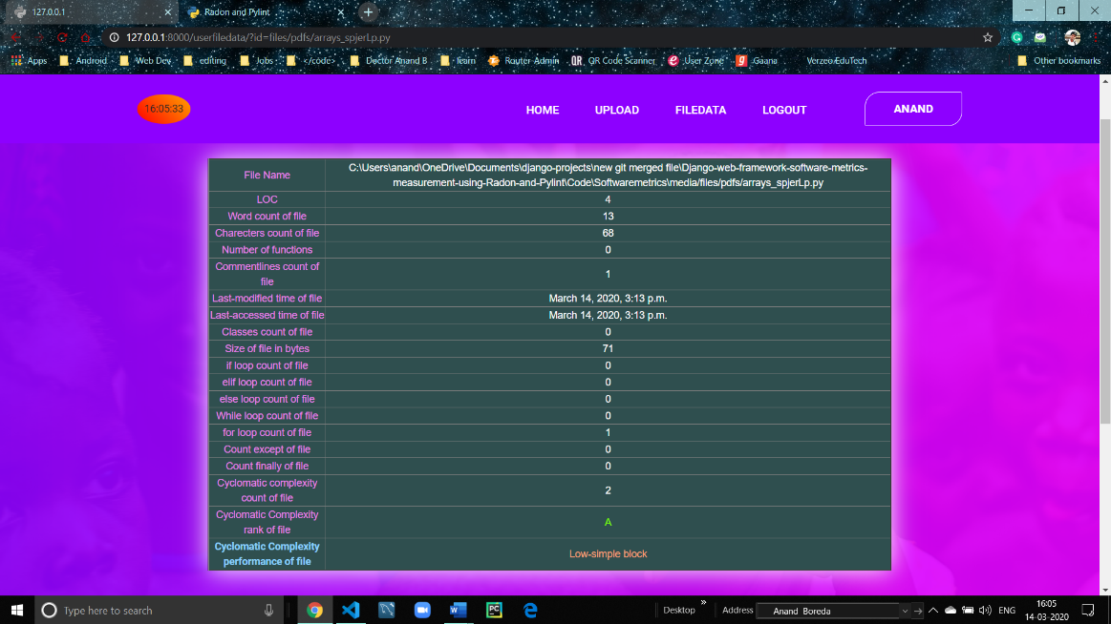

Slide 34
CONCLUSION
In conclusion, this paper has measure Django Web Framework code quality metrics. Django option in the main directory has 2,200 lines of code, Cyclomatic Complexity score is 16.375 considered as moderate complexity, and 6.69/10 by the pylint score. With the same method, other web frameworks can be measured too.

Slide 35
FUTURE ENHANCEMENT
In future we are planning to provide an API (application programming interface). There is an idea to launch an API for this model. We can actually do that using the Django REST Framework. Using the API, other authorized companies can get access to our functionality what we are having now.

Slide 36

THANK YOU

